Slide 1
Search page overview:
Explore fossil plants
Search
Taxa (OTU) | Specimen
Schema | Collections
Reference | Person
Quick Results viewed here
-data is clickable to make new tabs for further viewing.
e.g., results displayed here is a list of OTUs; then each OTU can be clicked to generate new tab displaying the full OTU page.
Search by name: If the user knows the name of what they are looking for, they can just type it here to quickly access the page for the OTU/specimen/schema/collection.
Display possible parameters to search by, based on what is clicked above. May need scrolling capabilities.
If this is selected, then this side of the screen is replaced with the equivalent of the “Choose Output Options” window in PBDB. Once we have the fields finalized, then we can work through what goes here for each type of search..
Show me more data! / Let me download data!
About
How to use PBot
Resources
Go back to PBot Home Page

Slide 2
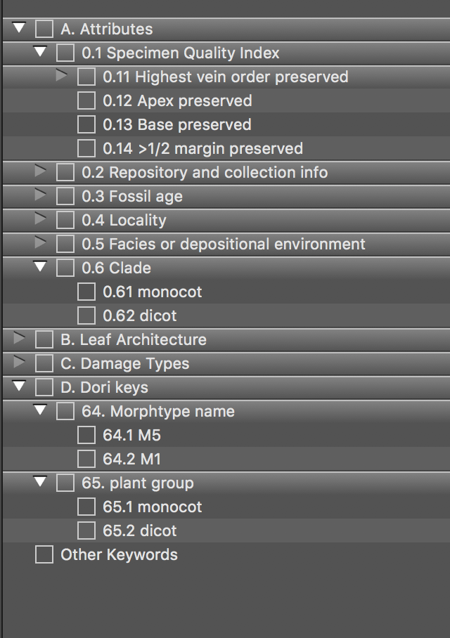
Search page- OTU selected:
Explore fossil plants
Search
Taxa (OTU)
Quick Results
Example of possible selection style: expanding drop down for the higher level things, then text entry where relevant
Search OTU name:
OTU Name (clickable link to bring up page in new tab/window) | Major clade | Plant part | Age (one key field) | Location (one key field) | # Specimens | Entered by
Ellen’s Head | Dicot | leaf | Miocene | Ethiopia | 43 | Ellen Currano
Dicot XXV | Dicot | leaf | Eocene | USA | 1 | Scott Wing
Metasequoia occidentalis | Conifer | leaf, cone, pollen | Cretaceous-Oligocene | Russia, USA, Canada | 10 | Claire Cleveland
Search by Taxonomy
Major taxon group
PBDB parent taxon
Family
Genus
Authority
Search by Descriptive Data
Parts preserved
Schema Used to Describe
Character Instances
Search by Time
Interval or Ma range
Search by Location
Lat / Long fuzzy search
Search by Geologic Context
Name(s) of Geologic Strata
Search by Metadata
Collection name
Person
Reference
Group
Show me more data! / Let me download data!
About
How to use PBot
Resources
Go back to PBot Home Page

Slide 3
Search page - specimen selected:
Explore fossil plants
Search
specimen
Quick Results
Search Specimen ID:
Specimen Name (clickable link to bring up page in new tab/window) | OTU name | Major Clade | Plant part | Age (one key field) | Location (one key field) | Entered by
MU7-45 | Ellen’s Head | Dicot |  | Miocene | Ethiopia | Ellen Currano
NMNH 47589 | Dicot XXV | Dicot |  | Eocene | USA | Scott Wing
EPI.7482648 | Metasequoia occidentalis | Conifer |  | Cretaceous | Russia | Claire Cleveland
Search by Taxonomy
Taxa (OTU) name
Major taxon group
PBDB parent taxon
Family
Genus
Search by Descriptive Data
Parts preserved
Preservation mode
Notable features preserved
Schema Used to Describe
Character Instances
Restrict to specimen data?
Also searches the OTU?
Search by Time
Interval or Ma range
Search by Location
Lat / Long fuzzy search
Search by Geologic Context
Name(s) of Geologic Strata
Search by Metadata
Collection name
Person
Reference
Group
Show me more data! / Let me download data!
About
How to use PBot
Resources
Go back to PBot Home Page

Slide 4
Search page - collection selected:
Explore fossil plants
Search
collection
Quick Results
Search Collection name:
Collection Name (clickable link to bring up page in new tab/window) | # OTUs | # specimens | Age (one key field) | Location (one key field)
MU7 | 15 | 80 | Miocene | Ethiopia
NMNH 0321 | 4 | 7 | Eocene | USA
DMNS 789 | 100 | 1009 | Cretaceous | Russia
Search by Taxonomy
Taxa (OTU) Name
Major taxon group
PBDB parent taxon
Family
Genus
Search by Types of Plant Fossils
Parts preserved
Preservation mode
Notable features preserved
Search by Time
Interval or Ma range
Search by Location
Lat / Long fuzzy search
Search by Geologic Context
Name(s) of Geologic Strata
Search by Metadata
Person
Reference
Group
Show me more data! / Let me download data!
About
How to use PBot
Resources
Go back to PBot Home Page

Slide 5
Search page- schema selected:
Explore fossil plants
Search
schema
# Search Results
Schema Name (clickable link to bring up page in new tab/window) | Reference | Plant part | Purpose
Manual of Leaf Architecture | Ellis et al. 2009 | Leaves | Describe leaves of dicots and similar.
Ellen’s awesome updates to MLA | Ellen’s private schema | Leaves | Additional MLA characters Ellen thinks are useful!
Fern Schema | PBot Fern Schema Working group 2023 | Foliage | Describe fern foliar material.
Search schema name:
Search by Purpose
Parts preserved
Taxon/Taxa described (this will only be in the purpose section, so will need to search what people type in purpose)
Search by Metadata
Person
Reference
Group
Search by Character(s)
About
How to use PBot
Resources
Go back to PBot Home Page

Slide 6
Person & Reference page seem straight-forward.

